Slide 1
Shaping the Future of the Internet in Africa
Dawit Bekele
Director, African Regional Bureau
Internet Society

Slide 2
Outline
The state of Internet in Africa
The Internet of opportunity
Challenges
Working for a brighter future for the Internet
Conclusion

Slide 3
The state of Internet in Africa

Slide 4

How We Work
Our mission: Promoting the open development, evolution, and use of the Internet for the benefit of all people throughout the world.
Operating at the intersection of policy, technology and development, allows the Internet Society to be a thought leader on issues key to the Internet’s continued growth and evolution.
TECHNOLOGY
DEVELOPMENT
POLICY

Slide 5
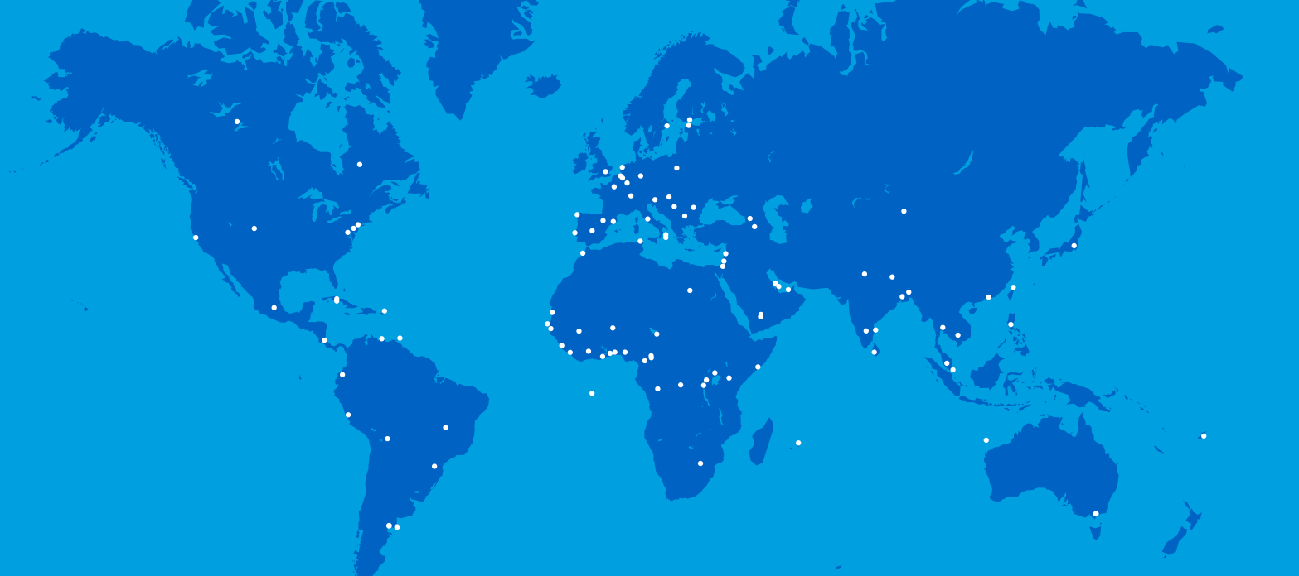
Global Presence Updated March 2015
EUROPE
NORTH AMERICA
THE MIDDLE EAST
ASIA
AFRICA
LATIN AMERICA/CARIBBEAN
More than
108
Chapters Worldwide
70k
Members and
Supporters
145
Organization Members
6
Regional Bureaus
Notes:
ALSO—partnerships with organizations such as OECD, World Economic Forum, International Chamber of Commerce, etc.

Slide 6
Africa before 2000
Less than 2% mobile penetration
International connectivity was using satellites for sub-Saharan Africa
National backbones were almost inexistent
Internet arrived in Tunisia and South Africa in 1991 and Egypt in 1993
Internet penetration was 0.78%
Broadband was almost inexistent

Slide 7
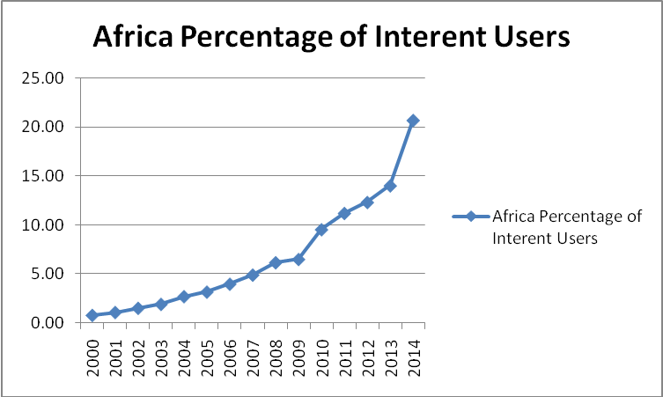
Growth of Internet penetration
Figure 1 Internet penetration in Africa (Sources: http://www.internetworldstats.com/stats1.htm; ITU (2014), the World in 2014: ICT Facts and Figures)

Slide 8
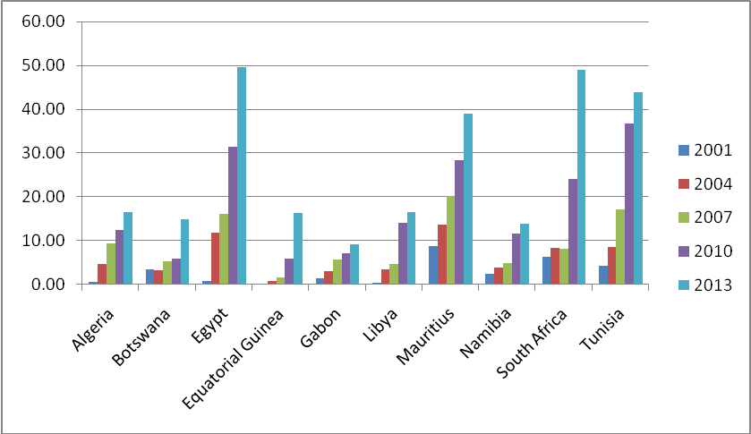
Growth of Internet Penetration in Top 10 countries
Source: ITU – the World in 2014: ICT Facts and Figures; 2014 World Bank Indicators on GDP per capita

Slide 9
ICT Indicators today
Indicator | Africa | World average
Internet penetration | 28.7% | 49.5%
Fixed telephone subscriptions | 1.3% | 15.8%
Fixed broadband | 0.4% | 9.8%
Mobile cellular subscriptions | 69% | 96%
Mobile broadband subscriptions | 19% | 32%

Slide 10
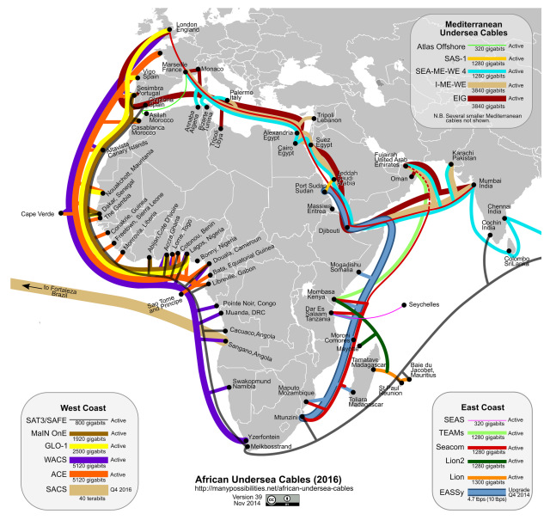
International connectivity

Slide 11
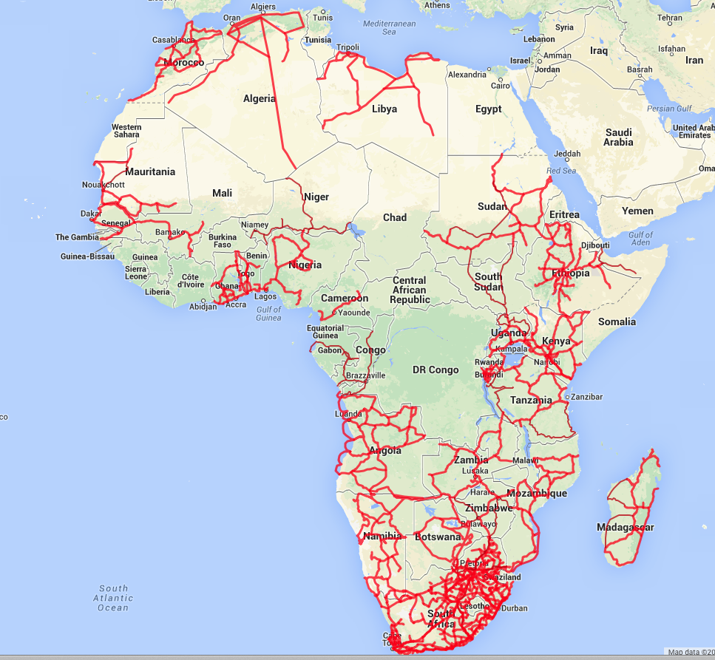
Terrestrial connectivity is moving in from coasts
Source: afterfibre.net

Slide 12
International connectivity
In just 5 years – from 2009 to 2014 Africa’s
  international bandwidth increased 20-fold
  terrestrial network more than doubled.
In 2011, inter-Africa Internet bandwidth was less than 2% of all the total international traffic
In 2015, it was about 10%

Slide 13
Rise of mobile communication
The primary means of Internet access is increasingly shifting towards wireless.
Wireless broadband
  3G/4G mobile data plans for tablet or smartphones
  free or paid Wi-Fi services offered by businesses, hotels, Internet cafés, and others
Increasing number of smartphones
  Nigeria (25%), Egypt (22%), Ghana (18%), Cameroon (17%), Kenya (13%) and Senegal (11%).

Slide 14
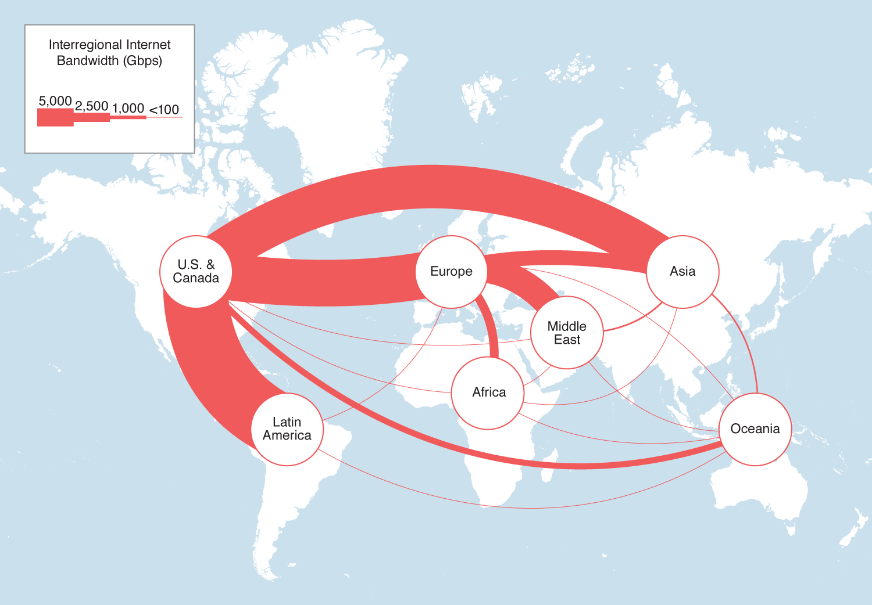
Inter-Regional Internet Bandwidth, 2015
Source: Telegeography

Slide 15
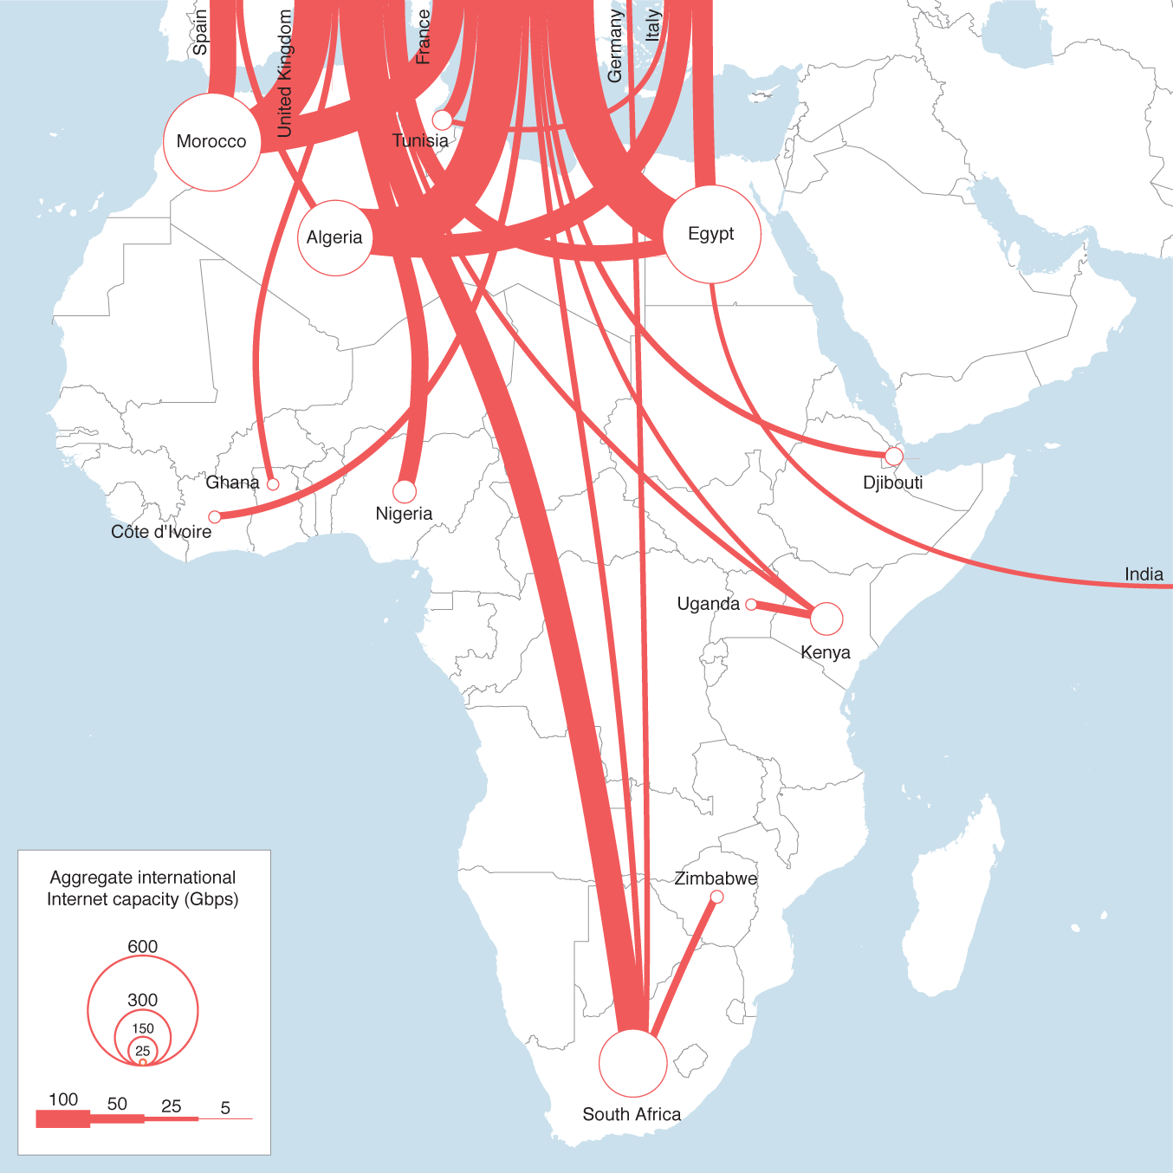
Major International Internet Routes in Africa, 2015
Source: Telegeography

Slide 16
The Internet of opportunity

Slide 17
Economic opportunity
Source: McKinsey and company

Slide 18
Social Opportunity
Increase reach, access and quality of education
Inclusion of disadvantaged communities
  Remote areas
  Women
  Sidelined communities
…

Slide 19
Political Opportunity
Africa is poor because it has been looted by its leaders and associates
  Mobotu Sesse Seko 1-5 Billion USD
  Sani Abacha 3 Billion USD
The Internet makes despotism, corruption, injustice more difficult

Slide 20
Challenges

Slide 21
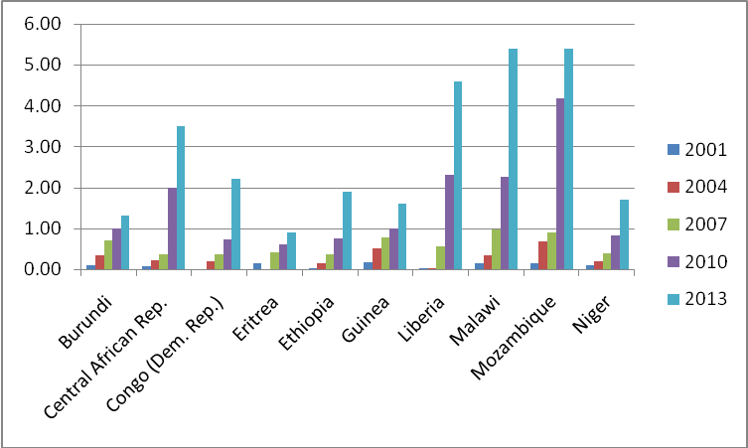
Disparity of Access
Percentage of Internet users: bottom 10 countries based on GDP per capita (Source: ITU – the World in 2014: ICT Facts and Figures; 2014 World Bank Indicators on GDP per capita)

Slide 22
Cost of access
Cost of access of country’s average GDP per capita
  less than 2% in most of Europe
  6.1% in South Africa
  7.4% in Sudan
  15.7% in Kenya’s average GDP
  31% in Uganda
  60.4% in Ethiopia

Slide 23
Quality of access
Interruptions
  Lack of redundancy
  Vandalism
  Government shutdowns
Bandwidth
  Last mile
  Content hosted outside the continent

Slide 24
Trust
Security is the most important policy concern
Personal data protection is a major concern
Businesses and governments are vulnerable
Children are targeted

Slide 25
Governance
Major victory with the IANA transition
Africa not always present in global forums
Lack of strong multistakeholder governance at local level

Slide 26
Working for a brighter future for the Internet

Slide 27
Interconnect Africa
  Domestic connectivity
    To connect landing stations, POPs, IXPs, etc.
    Rights-of-way policies raise costs
  Cross-border
    16 land-locked countries and others without landing station
    Often difficult to coordinate
Source: afterfibre.net

Slide 28
Access …
Promoting African content and applications
Keeping African content local to Africa
Meaningful access: access should change the lives of Africans

Slide 29
Trust
Collaborative security
    Fostering confidence and protecting opportunities:
    Collective Responsibility
    Fundamental Properties and Values
    Evolution and Consensus
    Think Globally, act Locally
Trust framework

Slide 30
Governance
Build strong regional and national institutions
  AFRINIC
  AFNOG
  AFTLD
  Internet Society
  APC
  NIC
  CERT
Increase presence in International governance
  Ex: IETF, ICANN

Slide 31
Conclusion

Slide 32
The Internet has already transformed Africa
However there is much more benefit that Africa can get from the Internet
We all have responsibilities to shape it so that Africa reaps the benefits
AFRICA NEEDS THE INTERNET AS MUCH AS THE INTERNET NEEDS AFRICA

